Slide 1

Government of Pakistan
National Vocational and Technical Training Commission
Prime Minister’s Hunarmand Pakistan Program
"Skills for All"
Course Contents / Lesson Plan
Course Title: Networking & Cloud Computing
Instructor : MADAM MEHAK ALI
ASSIGNMENT BY: MUZAMIL ALI SOOMRO

Slide 2


COMPUTER NETWORK AND TOPOLOGIES

Slide 3
COMPUTER NETWORK & TOPOLOGIES
NETWORK TYPES
NETWORK TOPOLOGIES
USE OF NETWORK

Slide 4
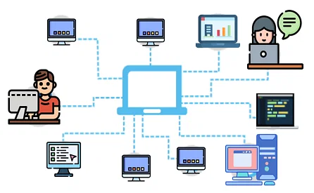
USE OF NETWORK
A computer network is a set of computers sharing resources located on or provided by network nodes. Computers use common communication protocols over digital interconnections to communicate with each other.

Slide 5

NETWORK TYPES
Types of Networks
PAN (Personal Area Network)
LAN (Local Area Network)
MAN (Metropolitan Area Network)
WAN (Wide Area Network)

Slide 6
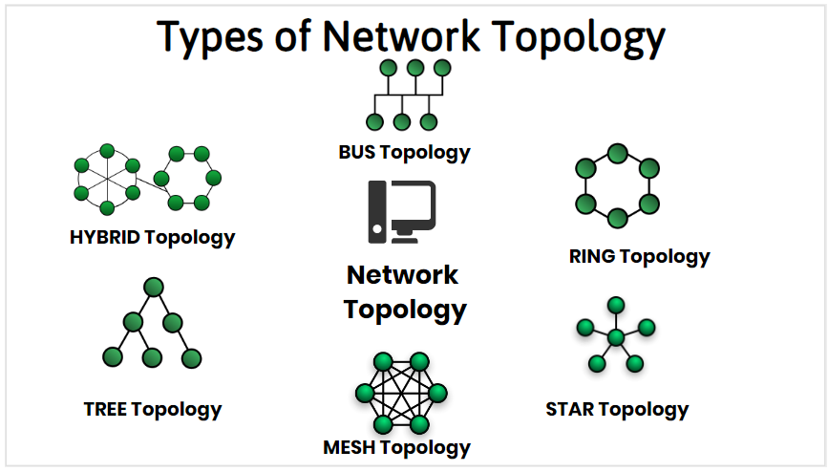
NETWORK TOPOLOGIES
Network topology is the arrangement of the elements of a communication network. Network topology can be used to define or describe the arrangement of various types of telecommunication networks, including command and control radio networks, industrial fieldbuses and computer networks.

Slide 7
THANK YOU FROM MUZAMIL ALI SOOMRO

